Slide 1
Capstone project Customer churn data analysis
Name: Nishanthi. A
Mentor: Jaya Pandey
Batch: DA22S2

Slide 2
Introduction
A certain bank in North America wants to perform customer churn analysis, as the credit card business of the bank is not performing very well.
As a data analyst, churn analysis will help the bank to evaluate the customers who have stopped purchasing the credit card of the bank and figure out measures to reduce the bank's customer loss rate.
Analyze the data to understand patterns, correlations, and trends related to churn. Visualizations and statistical techniques can help uncover insights about customer behavior.

Slide 3
Description
This dataset cotains 10127 rows and 20 columns.
There are 12 numerical columns and 8 categorical columns.
I have used some columns for my analysis.
They are attrition flag ,card category ,Income category ,gender ,region ,customer age ,education level ,credit limit

Slide 4
DATA PRE-PROCESSING
Out of 12 numerical columns,9 columns contains outliers.
Other 3 columns does not contains any outliers. They are total_relationship_count, total_revolving_bal, and avg_utilization_ratio.
Only 2 columns contains null values: card_category(132) and credit_limit(60)
Card category is a categorical column so null value is treated replacing mode value.
Credit_limit is a numerical column so null value is treated replacing mean value.

Slide 5
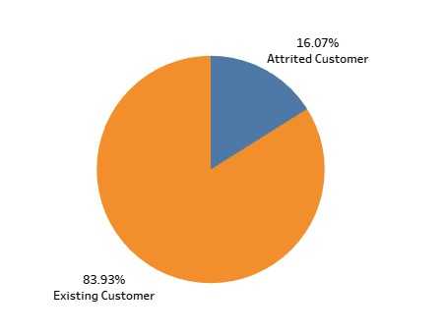
Task 1: Display the percentage of attrited and existing customers from the data.
Interpretation:
As per the pie chart,there are 16.07% of attrited customers and 83.93% of existing customers were present in the data.

Slide 6
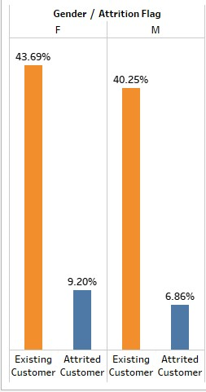
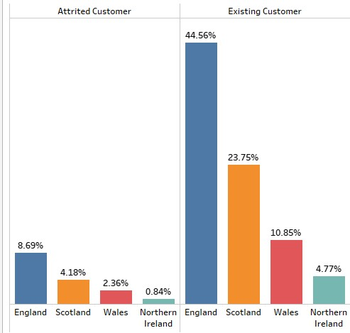
Task 2: Display the gender-wise percentage of the attrited and existing customers
Task 3: Display the region-wise percentage of the attrited and existing customers
Interpretation:
43.69% of females and 40.25% of males are existed customers where 9.20% of females and 6.86% of males are attrited customers who left the bank.Both attrited and existing customers having maximum count percentage in England region and minimum count percentage in Northern Ireland.

Slide 7
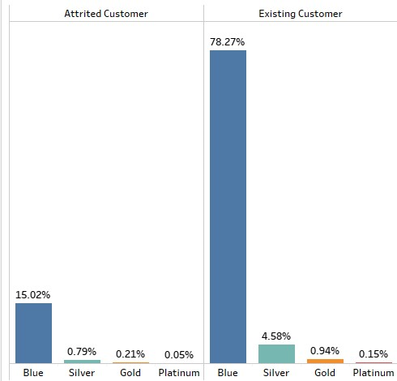
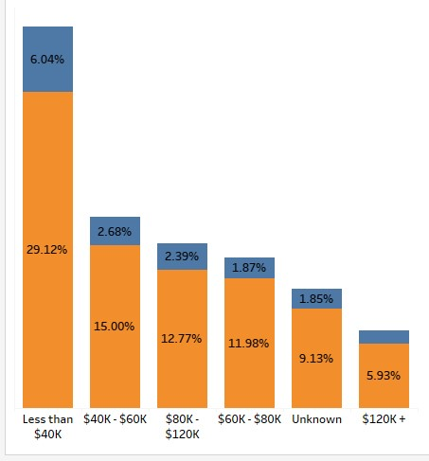
Task 4: Display the percentage of attrited and existing customers for each card category
Task 5: Display the percentage of attrited and existing customers for each income category
Interpretation:
Both customers have holding maximum of blue card category and minimum of platinum category and their income were mostly less than $40k.

Slide 8
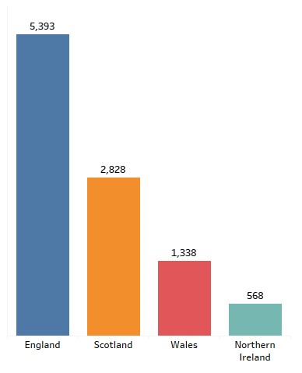
Task 6: Display the region-wise count of customers.Identify the region that has the maximum number of customers.
Interpretation:
There are 5,393 customers were from England and 568 were from Northern Ireland.

Slide 9
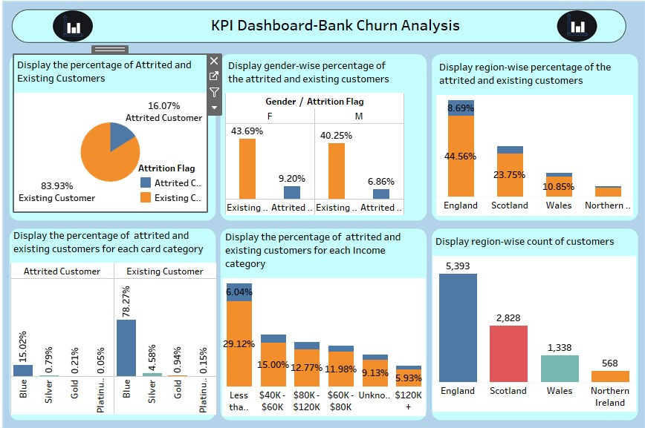

Slide 10
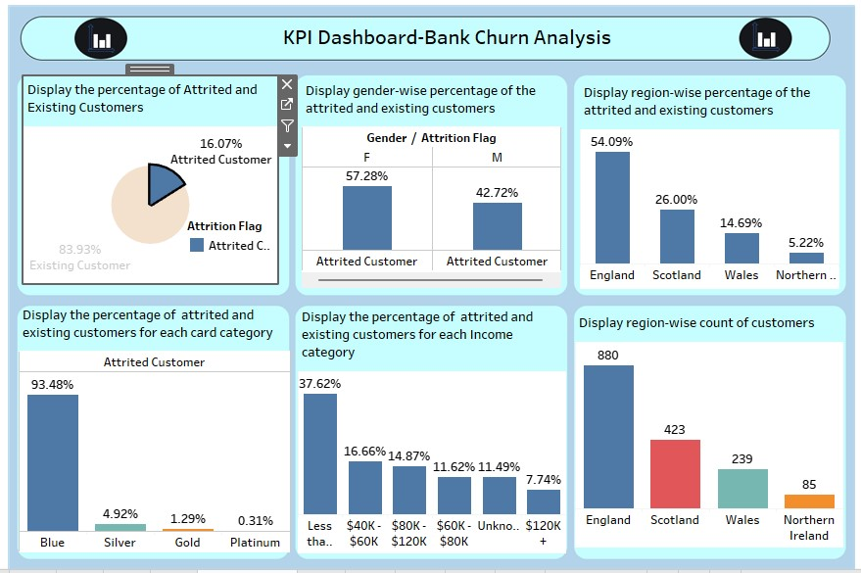

Slide 11
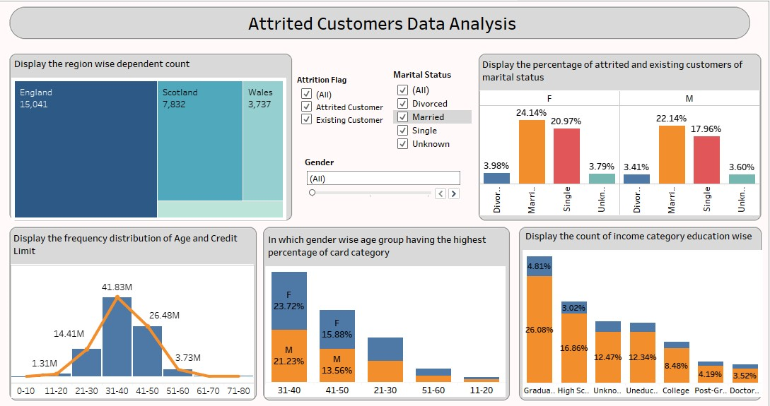

Slide 12
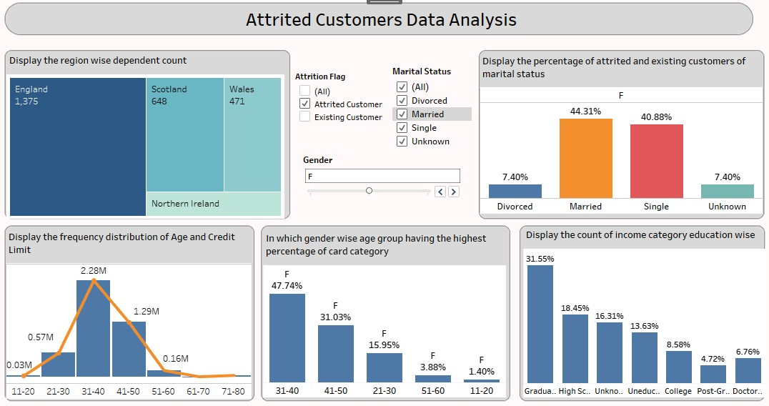

Slide 13
Conclusion
Totally, there are 16.07% customers are attrited.57% customers were female and 43% customers were male.
52.58% female attrited customers are from England and 56.12% male attrited customers are from England.
95.29% female attrited customers have blue card and 90.5% male attrited customers have blue card.
62.12% female attrited customers have income less than $40k and 34.53% male attrited customers have income between $80k-$120k.
294 female attrited customers are graduated and 193 male attrited customers are graduated.
44.31% female attrited customers are married and 42.59% male attrited customers are married.
693 female attrited customers have credit limit less than 5k and 224 male attrited customers have credit limit less than 5k.

